Slide 1
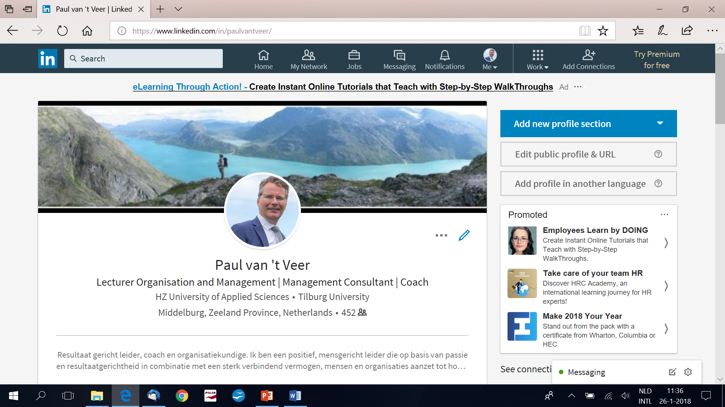

Slide 2
Student Manual

Slide 7
Basics of Financial Management Chapter 1
Rien Brouwers
Wim Koetzier

Slide 8
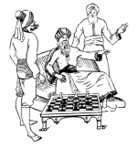
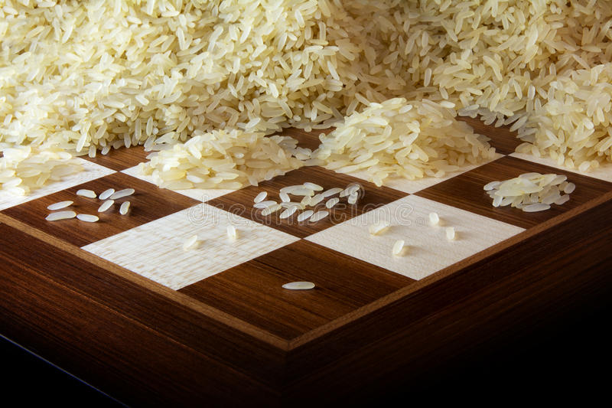
Notes:
Indian king Shirham, according to an old story, wanted to lavishly reward the inventor of the chessboard, Sissa ben Dahir, for his exceptional achievement. To the question of the king which reward he would wish for his invention, the smart Sissa replied: "Majesty, give me a cereal grain to put on the first square, two to put on the second square, four to put on the third box, eight to put on the fourth box, and let me, O king, cover each of the sixty-four squares of the chessboard. "The king was astonished at such a modest request, no more than a handful rice for this great invention! What is the reward? If the king had brought in his court mathematician, he would probably not be so happy with Sissa's proposal. Let's look at how much rice Sissa has dared to ask. On the first box there is only one grain of rice. The number of rice grains in each subsequent box is always double the number on the previous box. In total, Sissa asks for 1 + 2 + 22 + 23 + 24 + ... + 263. You can verify that this is equal to 264 -1, or written out: 18.446.744.073.709.551.615 rice grains. To get an idea of ​​this amount of rice, take a look at 50 grains of rice in a cubic centimeter. So we are dealing with a mountain of more than 3 × 1017 cubic centimeters, or up to three hundred billion cubic meters of rice. With this we could cover belgium and the netherlands with a meter thick layer of rice. Maybe Sissa was not that modest after all. ECONOMIC ACTIVITIES: Economics deals with issues that have to do with people in their pursuit of prosperity. How can this person be provided as optimally (? = With as little sacrifice of means) as possible in the goods / services that are needed. People need: a house, food, car, bicycle, 'step night', vacation .... This has to be produced. Man used to do all of this himself: he built his own house, rebuilt his own food. This has changed with exchange economy (?).

Slide 9

Business economics
Acting economically
Enterprises / Companies / Production organizations
Production factors
Profit
Notes:
Business economics: deals with economic activities within companies Acting economically: achieving objectives in as economical a way as possible Companies: organizations that produce something: good or service (not only car factory, but also car dealer and car repairer), not only tent manufacturer, but also camping) Acting economically within companies: using production factors (labor, machines, etc.) in the most efficient and targeted manner to obtain product / service. factors of production: raw materials, nature (?), But also sustainable factors of production: machines, buildings, soil (can be used for a longer period of time, not once). Work too. Capital: raw materials and sustainable means of production Enterprises: companies that aim for profit. What is profit?

Slide 10
Company
Production organization striving for profit
Transformation of production resources into end products
Collaboration of participants
Sales revenues
>
Costs of resources
Notes:
Why are firms producing goods and services?
Not only to make profit but also to continue, to continue to live and to grow.
Sales revenues > costs of resources: for the long term, now and than the difference will not be positive but you have to accept economic cycles.

Slide 11
Production process
Production process
Raw materials
Fixed assets
Labor
Supplier market
End products
Retail market
Money

Slide 12

What does this look like for beer?

Slide 13
Efficiency and effectiveness in the production process
Input
Trans-formation process
Output
Target realization
Efficiency
Unit Cost
Effectiveness
Sales revenue
Notes:
We have already seen: companies strive for value creation: Product yield> Costs of production resources. Surplus (profit) benefits owners. Depending on: efficiency (efficiency) of production process Effectiveness (goal orientation) of production process, degree to which end product satisfies customer requirements So: Efficient: production process with the lowest possible costs Effective: production process with end product that is popular with customers they would like to pay for Characteristic of enterprise: profit figure is a measure of both efficiency and effectiveness, because balance of turnover (measure of effectiveness) and cost price (measure of efficiency)
Cost per unit as low as possible, profit at the max.
Is this always valid?
If market is growing, sales is more important, developing a market share (example: Apple / iPad: margins ~40%, market share enormous
If market is mature, costs are more important, maintaining volume (at low margins) can still generate quite some profit (example: Ahold, Walmart, Carrefour)
How do you know costs are as low as possible?
Benchmarking, compare yourself with the competition
Mission statement:
- why?

Slide 14
Non-profit organization
Company
Market mechanism
Activities are means
Efficiency and effectiveness measured by profit
Public sector:
Budget mechanism
Private:
Fundraising
Activities are goal
Effectiveness measured by non financial criteria
Notes:
Government: provides collective goods / services
Market mechanism:
How does this work
Explain monopoly, oligopoly, etc.
Activities are means:
Example Nokia
Efficiency:
Measured by profit
Effectiveness:
Measured by market share
Budget mechanism:
Increase each year with inflation or more (example discussion on health care0
Benchmarking: comparing with other countries (number of civil servants France vs Germany)
Fundraising:
A bit of professionalism, outsourcing, see high cost of fundraising at Greenpeace

Slide 15
Production resources
Fixed Inventories Labor
assets
Agriculture Land Not important Nowadays
Machinery labor extensive
Mining Concession Not important Nowadays
Machinery labor extensive
Industry
mechanised/ Premises Mass production: Labor extensive
automated Machinery end product stocks;
job production:
no end product stocks
handcraft Less important Less important Labor intensive
Trade
wholesale Warehouse Very important Less important
Transportation
retail Store Important Labor intensive
Services Depends on Not important Depends on
type of service type of service

Slide 16
Aspects of the choice of a legal form
Management and ownership
Financing possibilities
Continuity
Liability
Tax consequences
Disclosure of financial information
Notes:
Management and ownership:
If owner is also manager, what happens when owner dies (or disappears)? The firm is quite vulnerable. Same as for small family firms, who will be the successor, is there a successor?
When you have an owner but also a management which deals with the day-to-day operation? The presence of an owner is not so important anymore.
Plays also a role with a dominant owner (Steve Jobs of Apple, question: is Apple viable after his death?)
Financing possibilities:
A one-owner company is, like said above, vulnerable. Banks will be more reluctant to provide funds. With e.g. Shell, this is not the case, whoever is running Shell is not that important.
Continuity:
Same as owner, with only one owner, continuity may be at risk.
Liability:
Who is responsible?
Tax consequences: will differ depending of the legal form
Disclosure of financial information: some legal forms require more transparency/ external reporting

Slide 17
Legal form
Sole proprietorship
Partnership
Joint-share company
LLC
PLC
Cooperative
No
No
Yes
Yes
Yes
Legal entity?
Notes:
Legal entity: company itself is considered a party in legal agreements. Labor contract with employee? Notarial deed for purchase of a building? Sales contract? Financing agreement for purchasing machine?

Slide 18
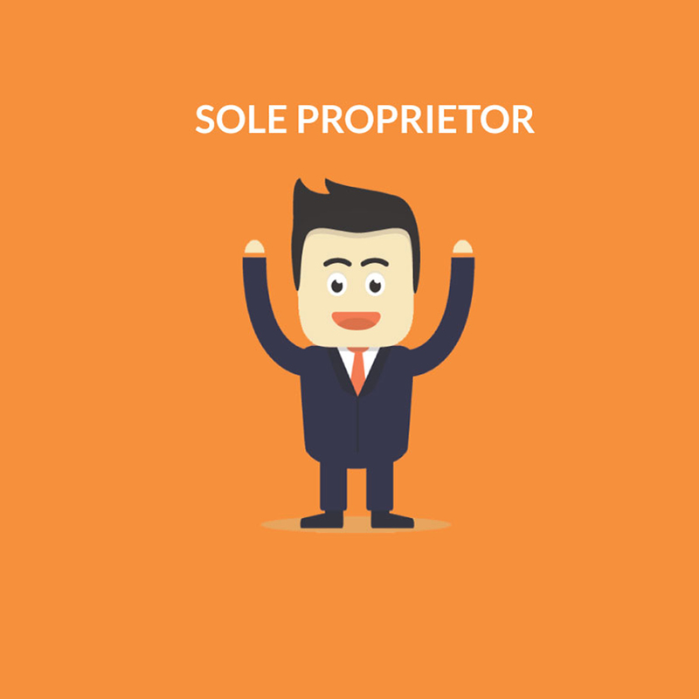
Notes:
Leader = owner Equity Liabilities ≠ control Others are employees Continuity depends on owner When owner falls away? Family, Key-man policy? Size limited, depending on start-up capital, starting entrepreneurs Growth in equity: top-up, reserve of reservation liability Private = Business So Income Tax (ascending disks) in Box I A bookkeeping obligation, no disclosure requirements (publication obligation). Why not?

Slide 19

Notes:
Collaboration of multiple partners Leadership = joint partners 2 is more than 1; input multiple expertise ≠ 1 captain Continuity ≠ 1 person Greater equity; buying into jointly and severally liable for the entire debt Partnership does not exist taxwise, each of them operates its own company. Income tax No obligation to publish Limited partnership: Limited partner: (partial) owner, no management nor private liability, no control
General partner: ownership + management

Slide 20
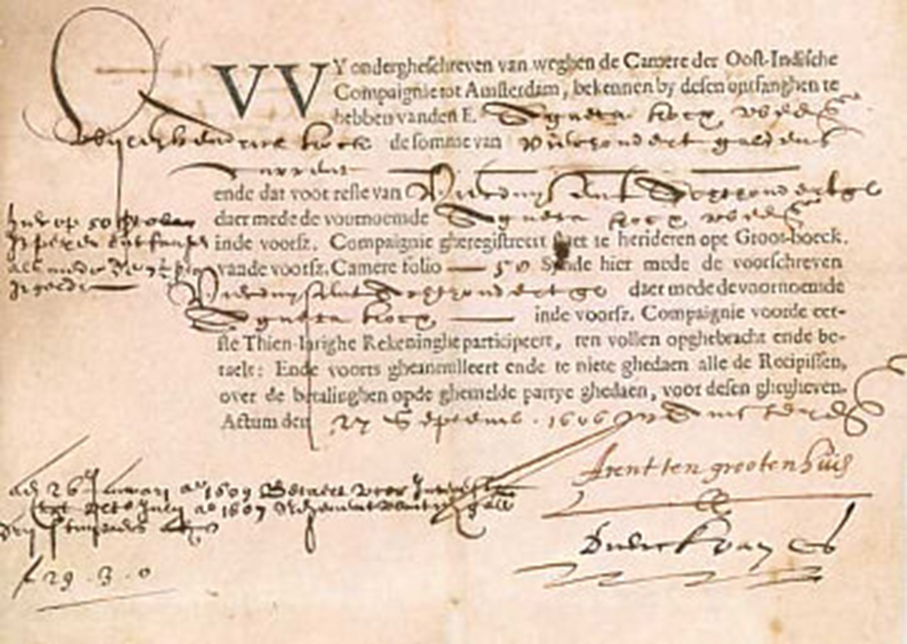
VOC
Notes:
Why shares? Risk reduction.
In the West-Frysian archive in the Dutch City of Hoorn the oldest share/ stock in the world was found. The share dates from 1606 and is issued by the VOC (Vereenigde Oostindische Compagnie or the Dutch East India Company). The VOC was a chartered company established in 1602, when the States-General of the Netherlands granted it a 21-year monopoly to carry out colonial activities in Asia. It is often considered to have been the first multinational corporation in the world and it was the first company to issue stocks.
A student in history found the share during his master thesis research. There were 1143 shareholders at the start of the VOC and soon a lively trade developed (Lodewijk Petram “De bakermat van de beurs”).
The document is on the name of 'Pieter Hermanszoon boode‘ from the city of Enkhuizer. After his death in 1638 his wife and daughter Ada inherited the share. Finally it came in the ownership of the city archive of Enkhuizen.
The share is very special since the inside contains detailed notes about issues of dividend.
The VOC was suffering big losses in the early years, so nothing could be issued to the shareholders. The notes, that continue until 1650, show that the dividends improved over the years.
In England it was forbidden until the 18th century to raise an N.V.

Slide 21
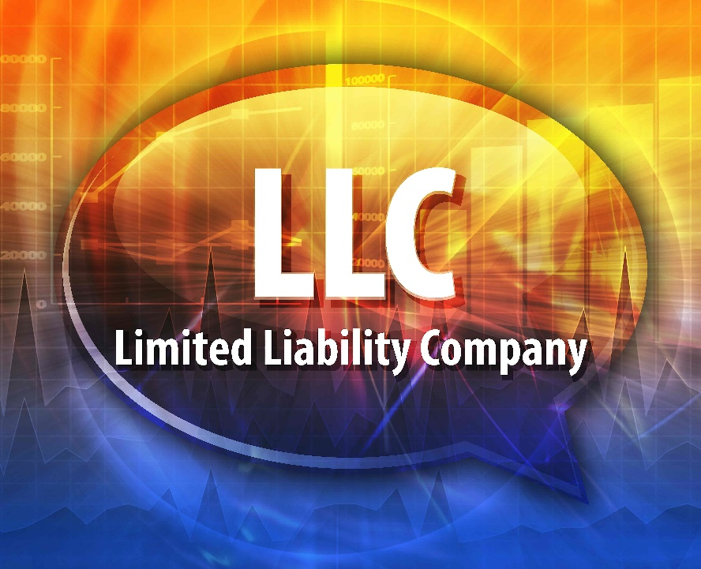
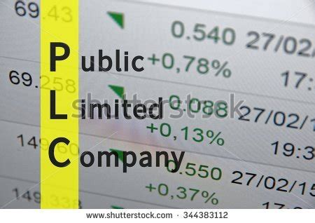
Notes:
LLC / BV PLC / NV
Separation ownership and management Shareholders' equity divided into shares General Meeting of Shareholders (AGM): highest power, including the appointment of board LLC: 1 or a few larger shareholders (DGA) PLC: raise large capital through stock exchange, many shareholders Supervisory Board: supervision of management on behalf of shareholders Expansion of equity: making a profit (not paying out to shareholders), or issuing new shares Continuity is better guaranteed Limited liability BV / NV: corporate tax on profit Shareholder: dividend tax (income tax) Disclosure requirements (trade register = Chamber of Commerce) Differences LLC / PLC LLC: registered shares PLC: bearer shares: easily tradable, anonymous LLC: option blocking clause PLC: always freely tradable LLC: no minimum starting capital PLC: at least EUR 45,000

Slide 22

Notes:
Members Cooperative carries out business on their behalf and does business with members Examples: Campina: milk Coop: supermarket Rabobank: bank Raiffeisen Members highest power Management appointed by members Continuity depends on the number of members and / or obligation not just to stop membership
legal liability
excluded liability
limited liability (maximum amount) Corporate tax Disclosure requirements

Slide 23
Liability
Legal form | Owners | Liability
Sole proprietorship | Owner | Fully
Partnership | General partners Limited partners | Severally Contribution
Joint-share company | Shareholders | Contribution
Cooperative | Members | Legal, excluded or limited

Slide 24
Tax
 | Corporate tax | Income tax
Sole proprietorship |  | On profit
Partnership |  | On profit
Joint-share company Shareholder | On profit | Classical tax system: On dividend Imputation tax system: On dividend less corporate tax
Cooperative Member | On profit | On profit payments

Slide 25
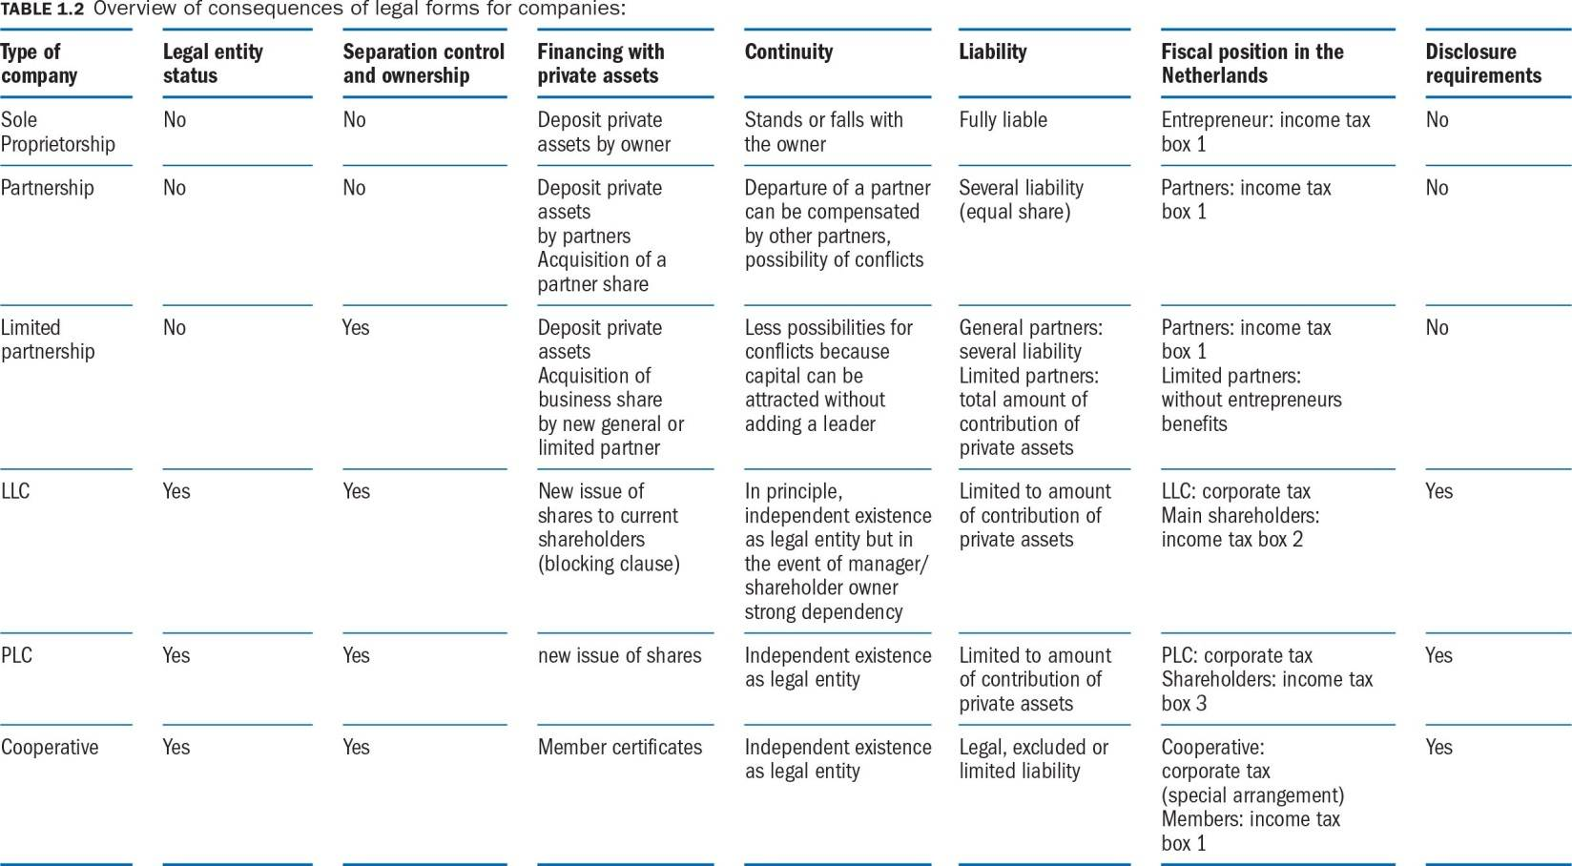

Slide 26
Basics of Financial Management Chapter 3
Rien Brouwers
Wim Koetzier

Slide 27


Slide 28
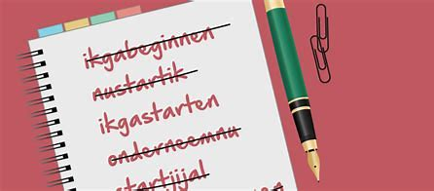
What do you need for starting your own business?
Notes:
Productiemiddelen.
Voorbeeld: handelaar met 2 mobiele telefoons, omzet EUR 40 mio.

Slide 29
I Balance sheet
II Income statement /Profit and loss account
III Cash flow statement

Slide 30
The balance sheet
Balance sheet
Serve the business for more than one year
Fixed assets
Equity
Owners
Indefinite period
Compensation depends on profit
Risk-bearing
Time between purchase and use is shorter than one year
Current assets
Liabilities
Creditors
Temporary
Usually fixed compensation
Risk-avoiding
Notes:
On the balance sheet, is indicated which investments have been made by a company (debit side) and in which manner these have been financed (credit side).
Assets: fixed / floating Rent a Bike: Bicycles (Rental property Tools Lubricating oil stock Paper Sports drink Company outing: debtors - receivable Cash money Money on bank account Liabilities Equity. From whom does this come from? (EZ, Vof, BV, NV) For an indefinite period of time> no agreements about reimbursement in advance. Control. Risk-bearing! Profit is compensation for posting. deduction. Debt. Temporary> advance agreements about reimbursement. Interest is compensation for posting. Risk avoiding .. Not risk-free, the higher the risk, the higher the interest rate. Bankruptcy, who first? No formal control. Balance? ALWAYS in balance Confrontation value of means of production, the way in which they are financed Shareholders' equity increases due to profits! Can Equity also become negative? TESLA
The investments are called assets and are divided into fixed (of service for more than a year) and current (of service for max a year).
For the method of financing a distinction can be made between equity and liabilties.
Equity has been made available to the company by the owner(s) for an unlimited period of time. The remunaration they will receive for making this available, is the profit. Equity is risk-bearing capital, because the remuneration isn ot fixed and in the event of default, the equity providers only receive their investment back after all other creditors have been paid.
Liabilities are loans made available for a particular period of time by creditors. Their remuneration is interest, as it is determined in advance and in the event of default, they will be repaid first. Liabilities are considered to be risk avoiding capital.

Slide 31
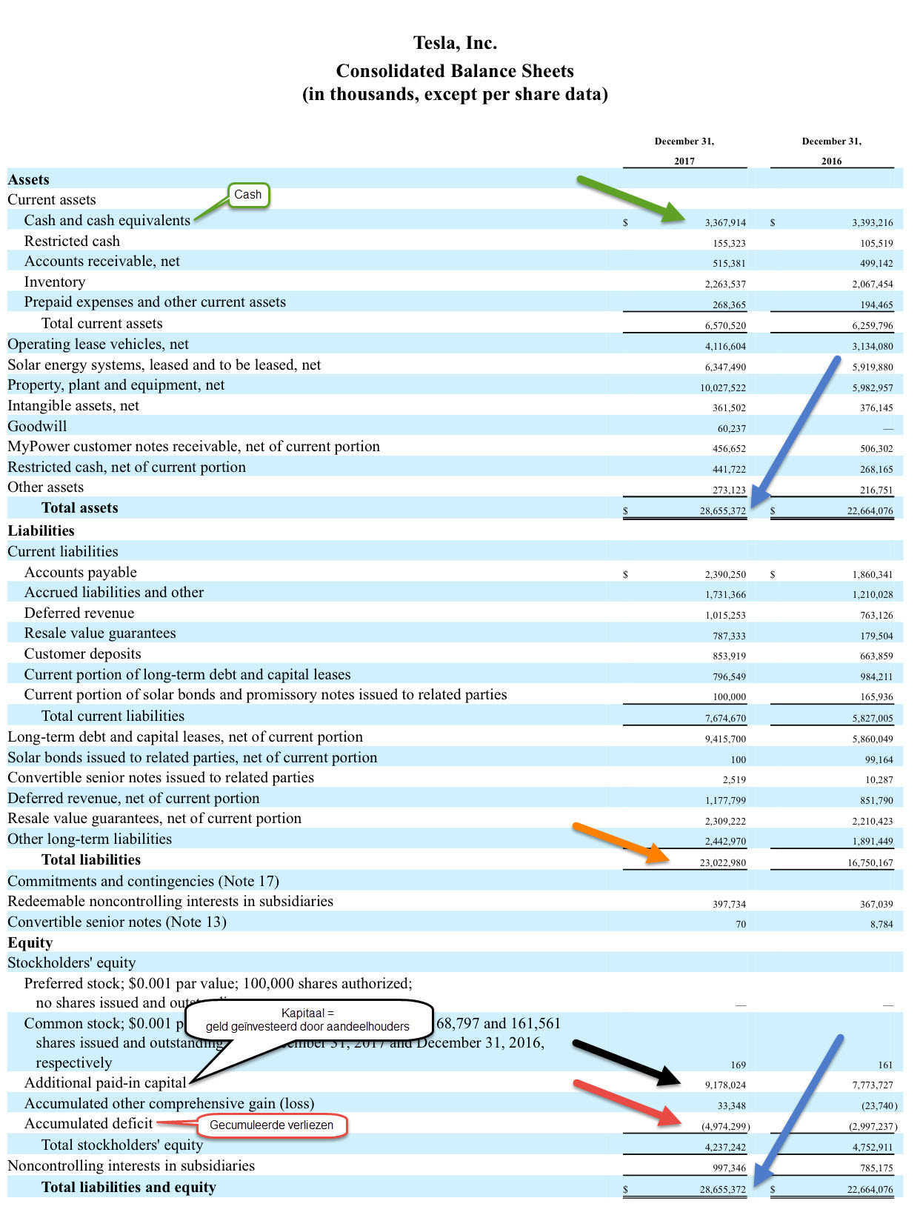

Slide 33
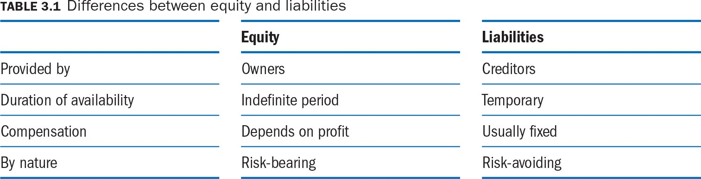

Slide 34
I Balance sheet Example 3.1 La Paz
Balance sheet at 1 January 2016 (in euros)
Fixed assets |  | Owner’s equity | 20,000
Car | 30,000 | Liabilities
 |  | Bank loan | 10,000
 | 30,000 |  | 30,000
Notes:
In the beginning (2016) of La Paz, the company needs a car, wich is a fixed Asset (more the one year in the company). It will be financed by the owners equity (20.000) wich is provided by the owners svings and a bank loan (10.000). The balance is always even. Every euro on the debit must be financed on the Credit site.
The equity of a company is equal to the diferencebetween the value of the assets and the liabilities (debts). (30.000 – 10.000) =20.000.
After the the company has started to ru the business activities, equity should, hopefully, increase as a result of the profit the business makes.
Profit ca determined by assessing the increase of equity during a certain period.
Example

Slide 35
Example 3.1 Final Balance sheet
Balance sheet at 1 January 2016 (in euros)
Fixed assets |  | Owner’s equity | 20,000
Car | 30,000 | Liabilities
 |  | Bank loan | 10,000
 | 30,000 |  | 30,000
Balance sheet at 31 December 2016 (in euros)
Fixed assets |  | Owner’s equity | 30,100
Car | 27,000 | Liabilities
Current assets |  | Bank loan | 8,000
Accounts receivable | 2,000 | Rent payable | 500
Bank (current account) | 9,600
 | 38,600 |  | 38,600

Slide 36
Profit determination
Balance sheet at start of period
Increase of Equity = Profit
(Except for private contributions and private drawings)
Balance sheet at end of period
Income statement specifies the composition of profit
Notes:
By comparison of equity at two balance sheet moments, the profit can be calculated. In principle an increase of equity is the profit.
However if one of the owners has withdrawn or deposited money, a correction must be made.
The other way to determine profit is by drawing up an income statement. See II

Slide 37
Exercise E3.1

Slide 38
Balance sheet on 1 January 2014 (in euros)
Kitchen equipment | 10,000 | Equity | 58,000
Other equipment | 5,000
Prepaid rent | 40,000
Cash and cash equivalents | 3,000
 | 58,000 |  | 58,000

Slide 39
II Income statement: Revenues and costs
Profit and loss account XXXX (in euros)
Turnover
Purchases
Depreciation
Rent
Insurance
Energy
Salaries
Interest on bank loan
Profit
Notes:
The income statement or profit and loss account gives an overview of the sales revenues and costs during a particular period.
Sales revenues is not necessarily equal to cash inflows ! The sales revenues due to sales transactions, should be recognized at the moment that the company has delivered the performance, even if the buyer has not yet paid. By definition, costs are not equal to cash outflows. Costs are taken when the actual use of a production factor occurs, regardless of the moment of payment. As a consequence the profit, as shown in the income statement, is not necessarily equal to the mutations in cash and cash equivalents.

Slide 40
II Income Statement Ex 1- La Paz
activities | Value (Euro)
Revenue (car rental) | 30,000
Received | 28,000
Still to be received | 2,000
Expenses Rental office (to be paid before the 10th following month) | 500 / month
Operating costs | 10,000
Interest on bank loan 9% | 900
Depreciation car (life time 10 years, end value=0) | 3,000
Notes:
What about the Bank loan (to be repaid 5 years x 20%)
10,000 ?

Slide 41
II Income Statement Ex 1- La Paz
Profit and loss account 2016 (in euros)
Turnover | 30,000
Depreciation car (over 10 years, equal amounts per year) | 3,000
Rent office space and garage | 6,000
Gasoline | 10,000
Interest on bank loan 9% | 900
Profit | 10,100

Slide 42
Continuation Exercise E3.1

Slide 43
Income statement 2014 (in euros)
Sales revenue | 100,000
Costs of goods sold | 38,000
Rent | 20,000
Wages | 20,000
Depreciation kitchen equipment | 1,250
Depreciation other equipment | 1,000
Energy costs | 4,800
Other costs | 10,000
 | 95,050
 | 4,950

Slide 44
Balance sheet on 31 December 2014 (in euros)
Kitchen equipment | 8,750 | Equity | 62,950
Other equipment | 4,000 | Accounts payable | 5,000
Inventory | 2,000 | Other payables | 1,200
Accounts receivable | 2,500
Prepaid rent | 20,000
Cash and cash equivalents | 31,900
 | 69,150 |  | 69,150
Cash and cash equivalents (in euros)
Status 1/1 | 3,000
Receipts sales 2014 | 97,500 | +
Purchases | 35,000 | -
Wages | 20,000 | -
Energy costs | 3,600 | -
Other costs | 10,000 | -
Status 31/12 | 31,900
Reconciliation of income statement and balance sheet:
Equity 31/12 | 62,950
Equity 1/1 | 58,000
Equity increase = profit | 4,950

Slide 45
III Impact on Cash /Profit ??

Slide 46
Cash flow vs. Profit
 | Cash inflow/ Cast outflow | Revenue/ Costs | Difference on balance sheet
Sales | Cash inflow Payment by customer | Revenue Activities for customer | Accounts receivable
Fixed assets | Cash outflow Purchase | Costs Depreciation | Book value
Loans/Credit | Cash inflow Amount Cash outflow Repayment Cash outflow Interest | Costs Interest | Liabilities Liabilities ---
Provisions |  | Costs Increase provision | Provisions
Notes:
Profit can also be further analyzed by confronting revenues and costs. = Profit and loss account. Revenue ≠ receipts Revenues are taken in the period in which the company has performed services for clients, regardless of whether these performances have already led to payment in the same period Costs ≠ expenses Depreciation (expense on purchase, costs over period of use, to prevent peak / fall) Repayment of loan capital (do not lead to change in equity) Services Direct changes in equity CONTINUED QUESTION 3.1

Slide 47
III Cash flow Ex1- La Paz-2016
Cash Flow La Paz 2016 | Revenu/ Cost | Cash flow | Difference | Balance Sheet
Sales | +30000 | +28000 | 2000 | Account Rec
Rent | -6000 | -5500 | -500 | Rent Payable
Operating cost | -10000 | -10000 | 0 | /
Depreciation | -3000 | 0 | -3000 | Car -3000
Interest | -900 | -900 | 0 | /
Repayment loan | 0 | -2000 | -2000 | Loan-
Total |  | =9600
Notes:
Differences between revenu/cash in, and costs/cash out, lead to changes in one of the balance sheet items .
Column 3= Cash flow statement (direct method): the total change in cash during 2016 is represented by the total (+9600)

Slide 48
COST BUT NO CASH FLOW: 1. depreciation
Depreciation versus taxes
Three things are needed to calculate the depreciation:
Initial cost
Final value / remaining value
How long will the item be used in principle the technical life but in case the economical life is shorter, the economic life is used (even if the item is still technically capable of performing its duty)

Slide 49
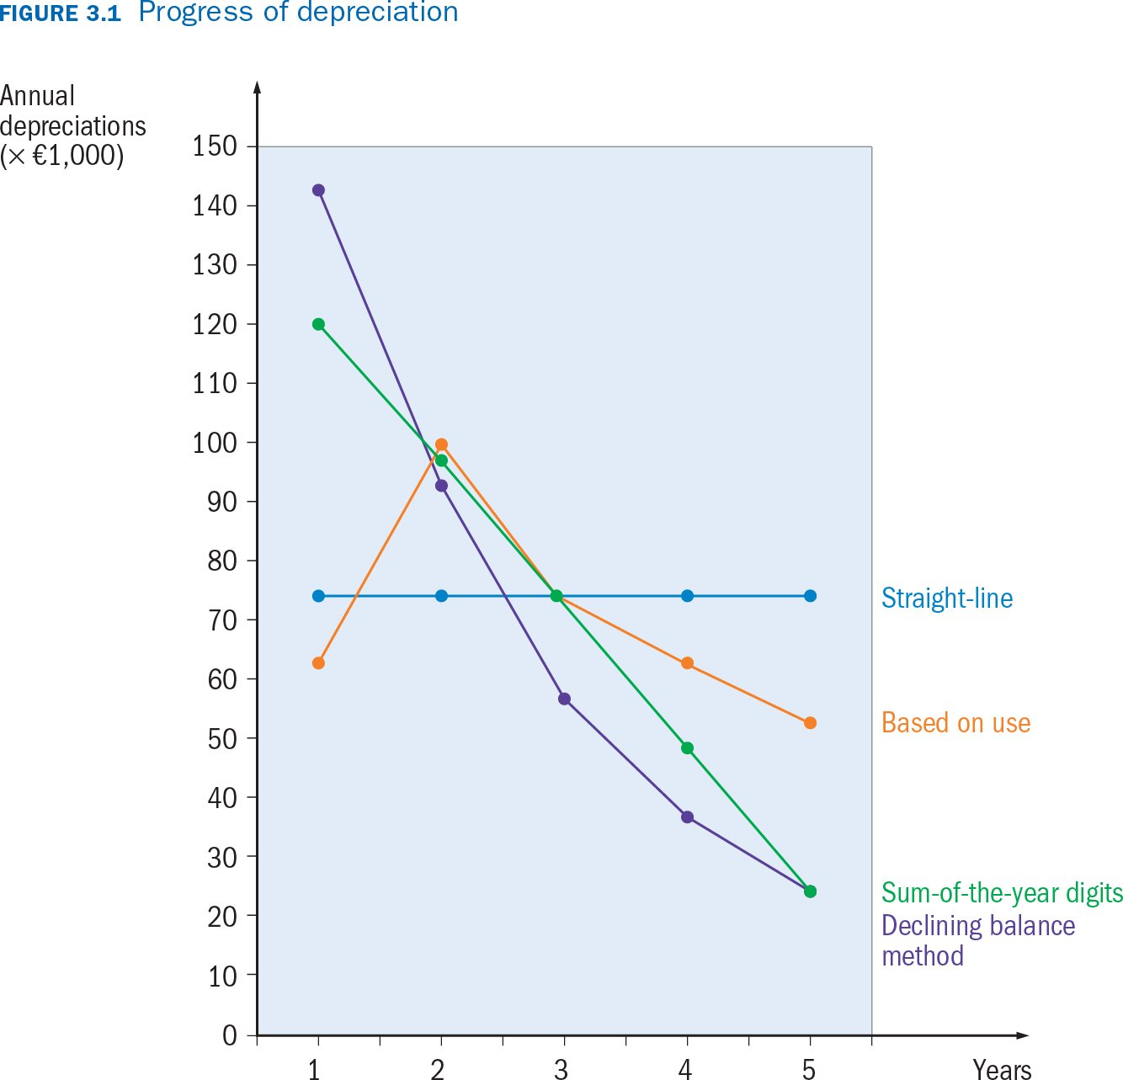
Notes:
Trough depreciation the purchase price of a production factor is divided over the years during which the production factor delivers a performance
Possible systems:
1. Straight line = lineair: the same amount every year
2. Accelerated during intital years more is depcreciated e.g. the sum-of-the-years’-digits, declining balance
3. Depreciation based on usage

Slide 50
COST BUT NO CASH FLOW: 1. depreciation
Question 3.4 page 25
A coach company buys a new coach for € 250,000 at the beginning of the year. Its estimated economic life is 8 years.
Show the amount of depreciation in the second year of use when each of the following methods is applied:
straight-line depreciation; estimated residual value € 40,000
Sum-of-the-years-digits method; estimated residual value 40,000
Declining balance method; depreciation by 30% of the book value
Notes:
a Yearly depreciation (€250,000 – €40,000)/8 = €26,250.
b In a life span of 8 years, the sum of the weighting is 1 + 2 + 3 + 4 + 5 + 6 + 7 + 8 = 36
Depreciation in the second year is 7/36 x €210,000 = €40,833.
c Purchase price €250,000
Depreciation in the first year: 30% x €250,000 = €75,000
Book value at the end of year 1: €175,000
Depreciation in the second year: 30% of €175,000 = €52,500.

Slide 51
COST BUT NO CASH FLOW: 2. provisions
Provisions are for possible future obligations, of wich the origin is in the financial year concerned.
Costs are already recognized, while the possible expenditure will only occur in the future.
Examples?
Notes:
Possible future liabilities -> costs but no expenses yet
Based on estimates -> subjective element, oppportunity for creative accounting (bonusses, loans,..)
Cash is king: cash is a fact, profit is an opinion: cashflow cannot be manipulated
Profit can be 'manipulated' by overly optimistic or pessimistic estimates
Creative accounting / Windowdressing

Slide 52
CASH FLOW BUT NO COST
3. Direct equity transactions
Private contribution | Income statement No influence | Balance sheet Equity increase
Private withdrawal | No influence | Equity decrease
Equity 31/12 Equity 1/1
Change in equity Owner deposits Owner withdrawals
Profit
Substract: Add:
Notes:
Direct changes in equity caused by private contributions/ withdrawals by the owners.
-> no impact on profit, but will change the cash position see example 3.4
An indirect way to calculate profit of year X: Equity on 31/12/X – Equity on 1/1/X – Private contributions + Private withdrawals.

Slide 53
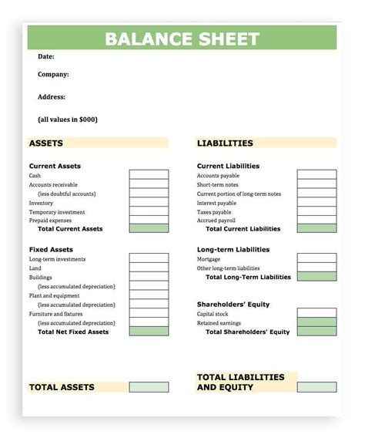

Slide 54
